Slide 1


Hope to Skills
Lecture# 15
Irfan Malik, Dr. Sheraz Naseer

Slide 2
Agenda
Recap
Visualization
Classification
Data preprocessing
Introduction to Scikit Learn
Quiz

Slide 3
Classification
Classification is a machine learning technique used to predict categorical or discrete target variables.
Types of classification problems: binary (two classes) and multi-class (more than two classes).

Slide 4
Data Preprocessing for Classification
Data preprocessing is essential to transform raw data into a suitable format for machine learning algorithms.
It involves cleaning, transforming, and encoding the data.
Preprocessing improves model accuracy, handles missing values, and deals with categorical variables.

Slide 5
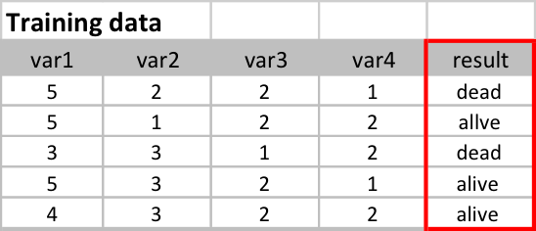
Selecting the Target Variable
The target variable is the variable we want to predict/classify.
It represents the outcome or label we are interested in.
Choose a meaningful target variable based on the problem at hand.

Slide 6
Introduction to scikit-learn
scikit-learn is a popular open-source machine learning library for Python.
It provides a wide range of tools and algorithms for classification, regression, clustering, and more.
Features include easy-to-use interfaces, extensive documentation, and integration with other scientific Python libraries.
https://scikit-learn.org/stable/

Slide 7
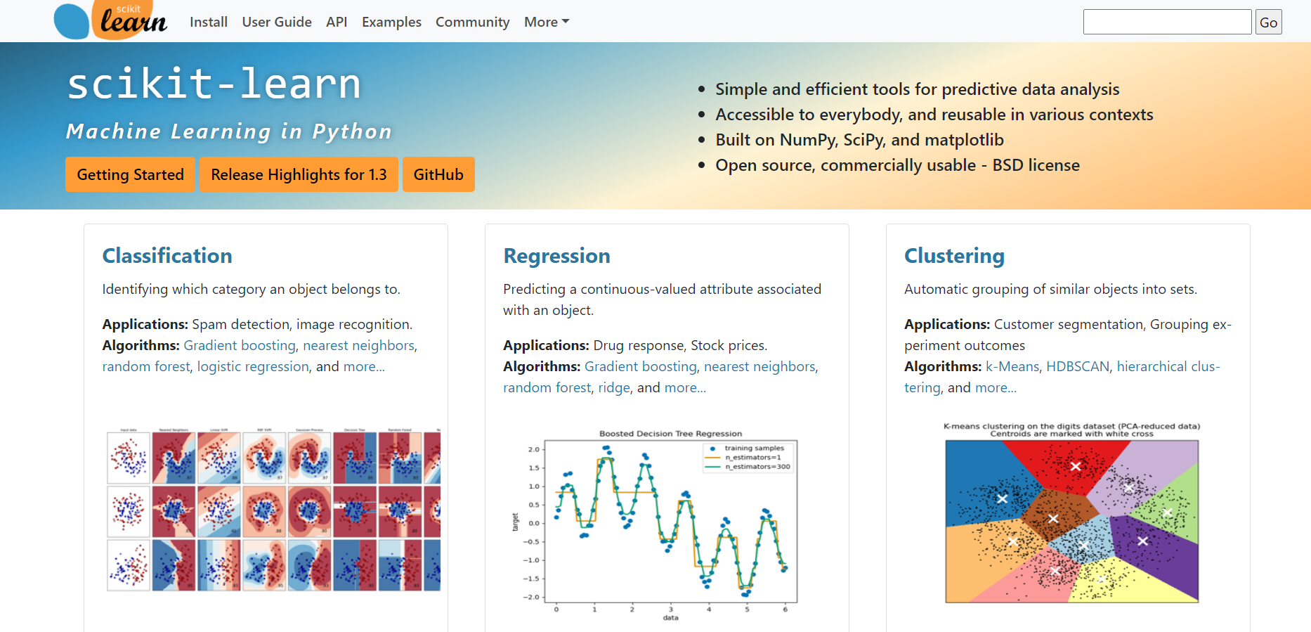

Slide 8
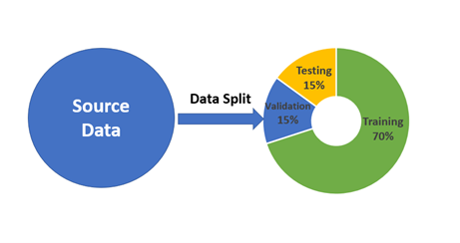
Data Splitting: Train and Test Sets
Splitting data into training and testing sets is crucial for evaluating model performance.
The training set is used to build and train the classification model.
The testing set is used to evaluate the model on unseen data.

Slide 9
Summary
Data preprocessing, target variable selection, and data splitting are crucial steps in classification tasks.
scikit-learn provides powerful tools for data preprocessing and simplifies the machine learning workflow.
Explore scikit-learn documentation and resources to learn more about its capabilities.

Slide 10
Lets move to Google collab

